Slide 1
205 Oct 28, Class 14
Experiment 2 additional background
  Baddeley & Hitch (2017)
  Ovalle-Fresa, Uslu & Rothen (2021)
  Modern rigor practices
APA format and Scientific writing
  Introduction: framing the question
  Discussion: drawing inferences

Slide 2
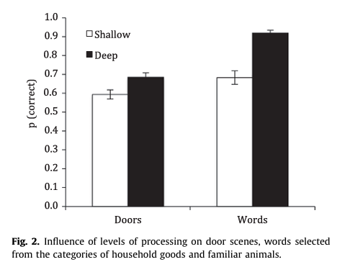

Slide 3
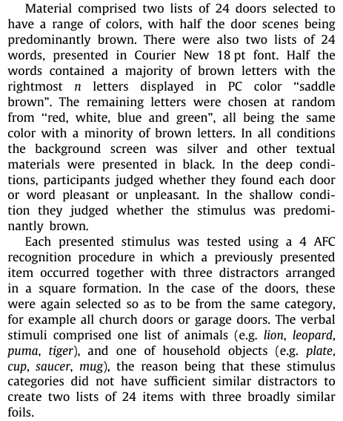
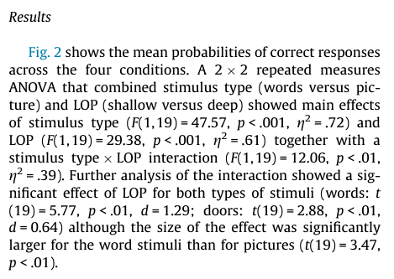

Slide 4
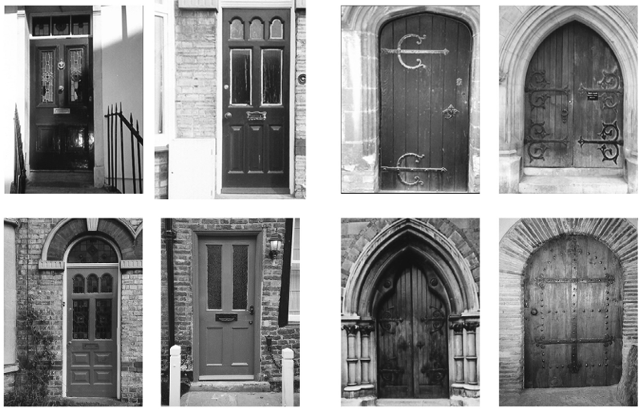

Slide 5
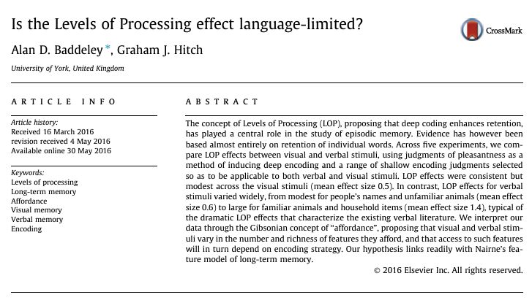

Slide 6
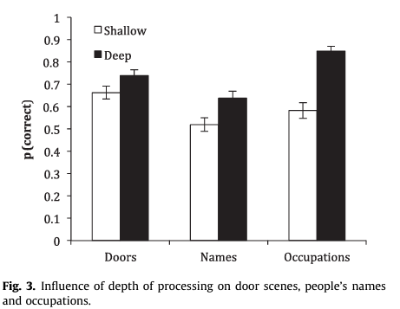
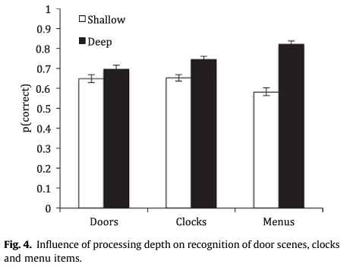
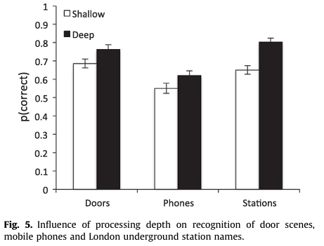
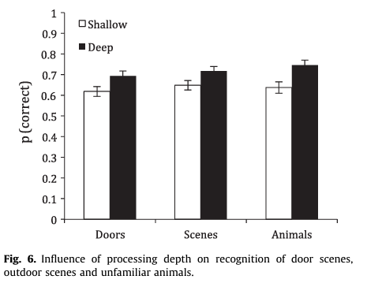

Slide 7
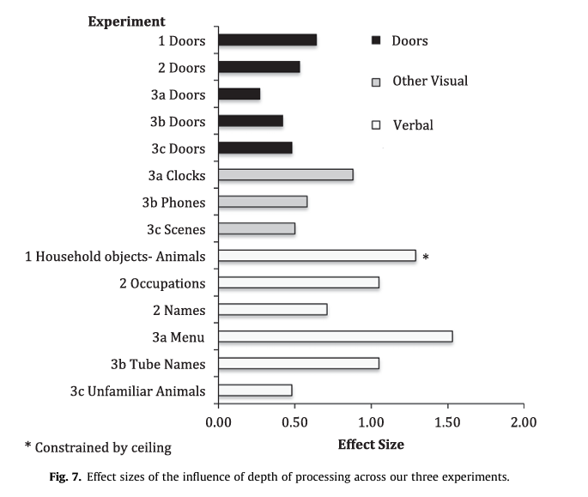
Using effect size estimates to view data across different studies
  Meta-analysis
Cohen’s d effect sizes

Slide 8
Effect size statistics
Cohen’s d
Generalized Eta-squared
Difference in means divided by the standard deviation
Estimated proportion of variance due to each factor and interaction
Effect Magnitude | Cohen’s d | Generalized eta-squared
Small | 0.2 | 0.02
Medium | 0.5 | 0.13
Large | 0.8 | 0.26
Very large | 1.2 | 0.40

Slide 9
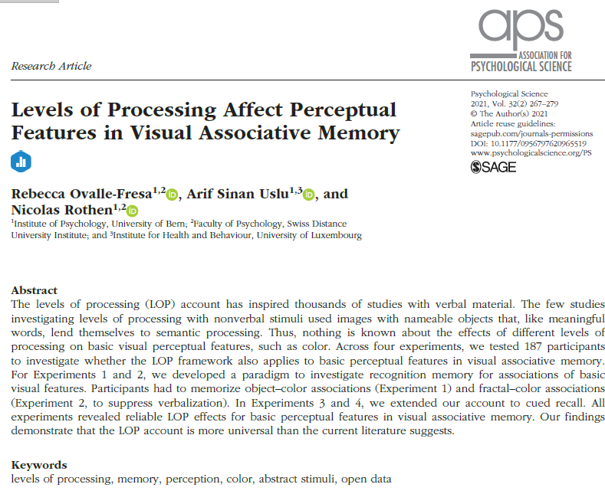

Slide 10
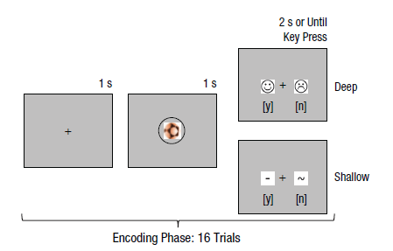
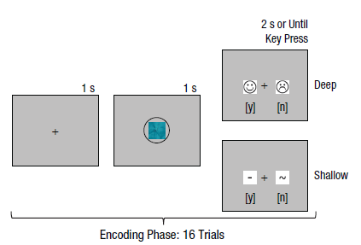
LOP with visual objects
Deep: yes/no pleasant
Shallow: yes/no contains straight line
Exp1: Instructed to try to memorize
object-color pairings
Exp2: Abstract images and color

Slide 11
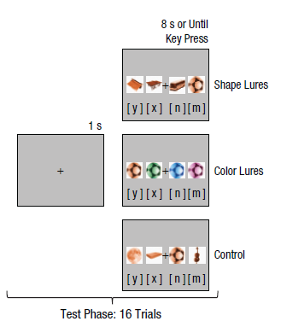
Recognition Memory
Four choices
Studied object and 3 “lures”
  Same color or
  Same shape
2x3 within-participant design
  Everybody does both kinds of study
  All three tests

Slide 12
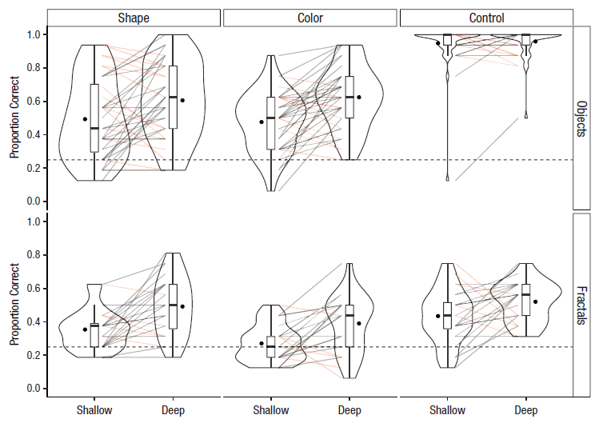
Effects
Violin plots
  Distribution of data
Deep > Shallow
in both studies

Slide 13
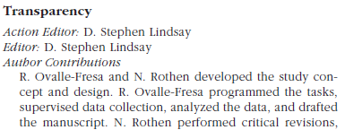
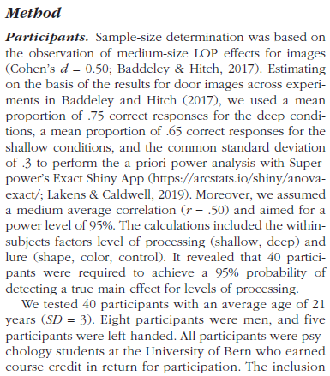
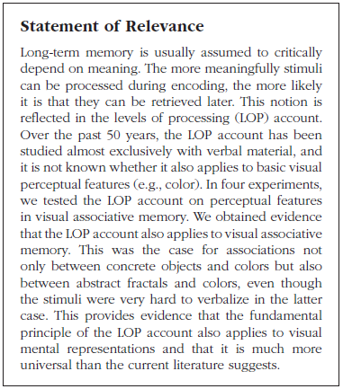
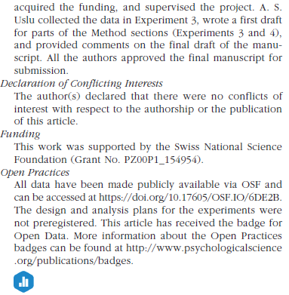
Modern reporting

Slide 14
Reproducibility of results
Concern: some well-known psychological science studies were found to “not replicate”
Good consequences: more attention is being paid to statistical inference
  Reduce focus on p-value, more on effect size and inference
  Replicating findings helps extend theory
Bad consequences: increased distrust of science
  Some ways to increase rigor will lead to less overall science
  Exposing gaps in statistical understanding

Slide 15
Power analysis
How many participants do I need for my experiment to work?
  Practical/convenience sampling: how many do you have?
  RCT: precisely estimated samples in advance
Probability of a statistically reliable result
  P = f(effect size, n)
Common targets
  80% power = 80% probability of seeing p<.05 assuming the IV has an effect
  Note that 20% of true findings still do not “replicate”

Slide 16
Open Practices
Make all data publicly available
  De-identified
  Ideally pre-analysis, pre-exclusion
Make detailed methods available
  Supplemental Materials
  Analysis scripts
Experiment pre-registration
  Semi-publicly post experiment design details before starting
  Requires effect size estimate, detailed analysis plan

Slide 17
APA Report Sections
Abstract
  Very concise summary, ~200 words
Introduction
  Construct, background, hypothesis
Methods
  Participants, materials, procedure
Results
  Figure
Discussion
  Conclusion, interpretation, limitations
References

Slide 18
Multi-experiment papers
Abstract
Introduction
Experiment 1
  Method
  Results
  Discussion (short, segue)
Experiment 2
  Method
  Results
  Discussion (optional)
General Discussion
References

Slide 19
APA Format: Methods
Which of the following is the main goal of the methods section of a research report?
  a. Meticulously articulate how you analyzed the data.
  b. Provide enough detail to allow an independent researcher to replicate your study.
  c. Outline the demographic information of your participants so that reviewers can access the generalizability of your research.
  d. Discuss the procedure you used so that readers can decide for themselves if your protocol is biased.

Slide 20
APA Format: Results
Which of the following is usually beyond the scope of the results section of a quantitative research report?
  a. Discussing what statistical techniques were used
  b. Presenting figures and/or tables to portray the data
  c. Providing detailed interpretation of the implications based on the data
  d. Presenting specific statistics that were generated from the data

Slide 21
APA Format: Discussion
If you state alternative explanations in your discussion, which of the following should you also consider doing?
  a. Tell readers why the alternative explanation falls short of the primary explanation
  b. Conduct statistics tests to test them specifically
  c. Include reviewer opinions of whether they think the alternative explanation is better or worse than the primary explanation
  d. Present a literature review that would allow readers to conduct a follow-up study based on the alternative explanation

Slide 22
APA Writing with Style
What is the role played by answering the question “who will you write for” in writing a research report? How should the answer influence the writing process?
Citing previous research
  Craik & Tulving (1972) proposed that better memory would research from more semantic engagement with the material being studied and termed this “deeper” processing.

Slide 23
Research Context
Building on existing work
  Strengthens confidence in conclusions
  Very briefly review theory/mechanism
Adding something new
  What is new about our study?
  Motivate the current study to add to prior work

Slide 24
For Wed 10/30
Experiment 2 analysis
Exam review
Chapter 13, Developing a Research Proposal
  Finding background reference that might be a good starting point for your final project
  Use this paper as a writing example to look at style of writing the Introduction and Discussion

